Slide 1
Graph Neural Networks: A Review of Methods and Applications
Jen Jen

Slide 2
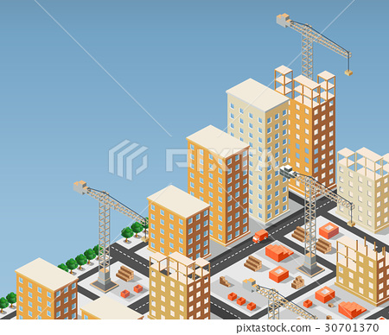
What we are going to go through today
Traditional GNN and its limitation
The improvement of GNN
What kind of problem GNN can solve

Slide 3

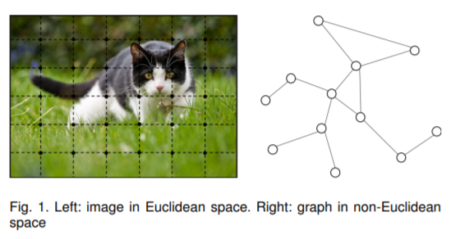
CNN and its current situation
CNN: local connection, shared weights and the use of multi-layer
CNNs can only operate on regular Euclidean data like images (2D grid) and text (1D sequence) while these data structures can be regarded as instances of graphs

Slide 4
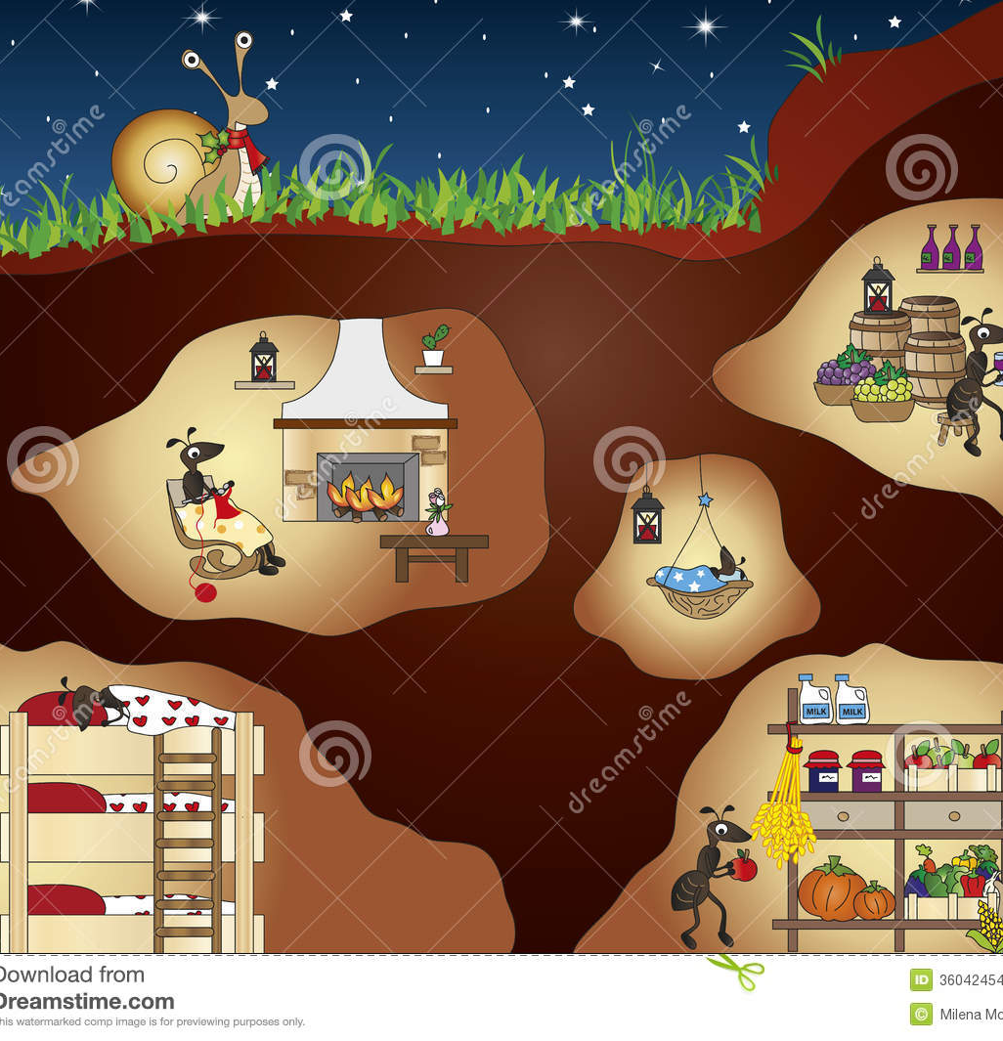
Traditional GNN
In a graph, each node is naturally defined by its features and the related nodes. The target of GNN is to learn a state embedding hv ∈ R s which contains the information of neighborhood for each node
f be a parametric function, called local transition function, let g be the local output function
hv = f(xv, xco[v] , hne[v] , xne[v]) (1)
ov = g(hv, xv) (2)
就是在搞一個output node
F, the global transition function, and G, the global output function are stacked versions of f and g for all nodes in a graph
Let H, O, X, and XN be the vectors constructed by stacking all the states, all the outputs, all the features, and all the node features, respectively
H = F(H, X) (3)
O = G(H, XN ) (4)
Ht+1 = F(Ht , X)
就是在搞一個graph 的status

Slide 5
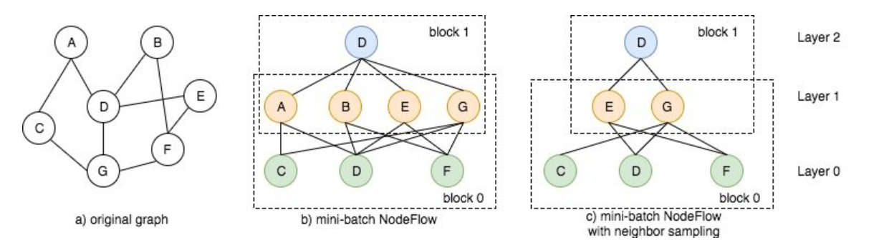
DGL: one of the frameworks
Batch job
Purpose : update D
CDF update ABEG
ABEG update D
Next patch

Slide 6
Traditional GNN-Limitation
It is inefficient to update the hidden states of nodes iteratively for the fixed point (更新固定點節點資訊太耗時惹)
GNN uses the same parameters in the iteration while most popular neural networks use different parameters in different layers( 一套參數在每一層用到景崩)
There are also some informative features on the edges which cannot be effectively modeled in the original GNN (人有邊緣人，edge有邊緣edge。改動起來太麻煩，乾脆不要動，直接忽略)
It is unsuitable to use the fixed points if we focus on the representation of nodes instead of graphs(有時候不是status改變，是Node 的意涵變了。E.G. 房子過戶)

Slide 7
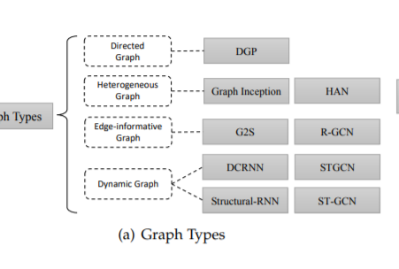
Variants of Graph Neural Networks
In the original GNN [33], the input graph consists of nodes with label information and undirected edges
螞蟻窩有單行道(簡化可能性)
蟻窩政府機關為一個子圖，娛樂商店為一個子圖，風化區為一個子圖，最後把所有子圖拼湊起來(二戰後德國城市規劃)
仁愛路4段+房價資訊(權重)，過戶問題可以解決
總統候選人造勢、馬拉松(INPUT) -> 動態改道資訊

Slide 8
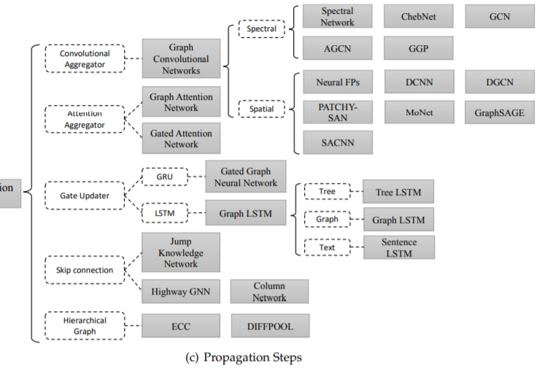
Propagation Types
這裡蒐集了很多篇論文的觀點，分別介紹不同的node, edge 更新方法
看完兩種發現頭髮少了一點，決定暫時收工
規劃一個產業園區，絕對不只一種方法

Slide 9
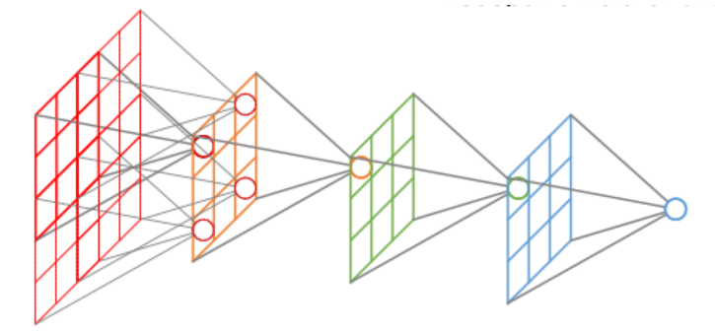
Training type
The original graph convolutional neural network has several drawbacks in training and optimization methods. Specifically, GCN requires the full graph Laplacian, which is computational-consuming for large graphs. Furthermore, The embedding of a node at layer L is computed recursively by the embeddings of all its neighbors at layer L − 1
矩陣計算耗時，蓋大樓一層比一層難蓋，蓋4樓要等三樓完工
Solution
Sampling replaces full graph Laplacian (Laplacian矩陣)
Receptive Field Control
Data Augmentation ( 增加訓練資料集)
Unsupervised Training( 應該是演算法特性)
Receptive field
Notes:
Receptive Field : https://medium.com/mlreview/a-guide-to-receptive-field-arithmetic-for-convolutional-neural-networks-e0f514068807

Slide 10
GNN Application
Structural Scenarios
social network prediction, traffic prediction, recommender systems and graph representation, Finger prints
Non-structural Scenarios
Text classification, Image classification, object detection, interaction detection, and region classification, sequential labeling
Other Scenarios
Generative Models(social relationship model)
個人認為，GNN 處理的還是監督學習問題，根據結果或標籤進行梯度更新
Notes:
Computer Vision, Recommender Systems, traffic(speed and density) , chemistry( protein and compound)

Slide 11
Open questions
Shallow Structure: graph neural networks are always shallow, most of which are no more than three layers. As experiments in show, stacking multiple GCN layers will result in over-smoothing, that is to say, all vertices will converge to the same value(層數很重要)
Dynamic Graphs: When edges and nodes appear or disappear, GNN can not change adaptively(GOOGLE MAP 店家歇業, 營業時間更改)
Non-Structural Scenarios (第一步還是要結構化)
Scalability: How to apply embedding methods in webscale conditions like social networks or recommendation systems has been a fatal problem for almost all graph embedding algorithms (computing resource)

Slide 12
I realized…
GNN 規劃更新就像都市規劃一樣
GNN 可以解決結構OR非結構問題，只是在處理已結構化問題較強
如果要像京東一樣用GNN做到即時推薦，需要$$$$$$投入在硬體

Slide 13

Q&A
你問吧，但我真的答不出來

Slide 14
Reference
https://zhuanlan.zhihu.com/p/76025331
https://archwalker.github.io/blog/2019/07/07/GNN-Framework-DGL-NodeFlow.html
https://www.twblogs.net/a/5c8c6882bd9eee35fc14e953
https://zhuanlan.zhihu.com/p/75307407

